Slide 1
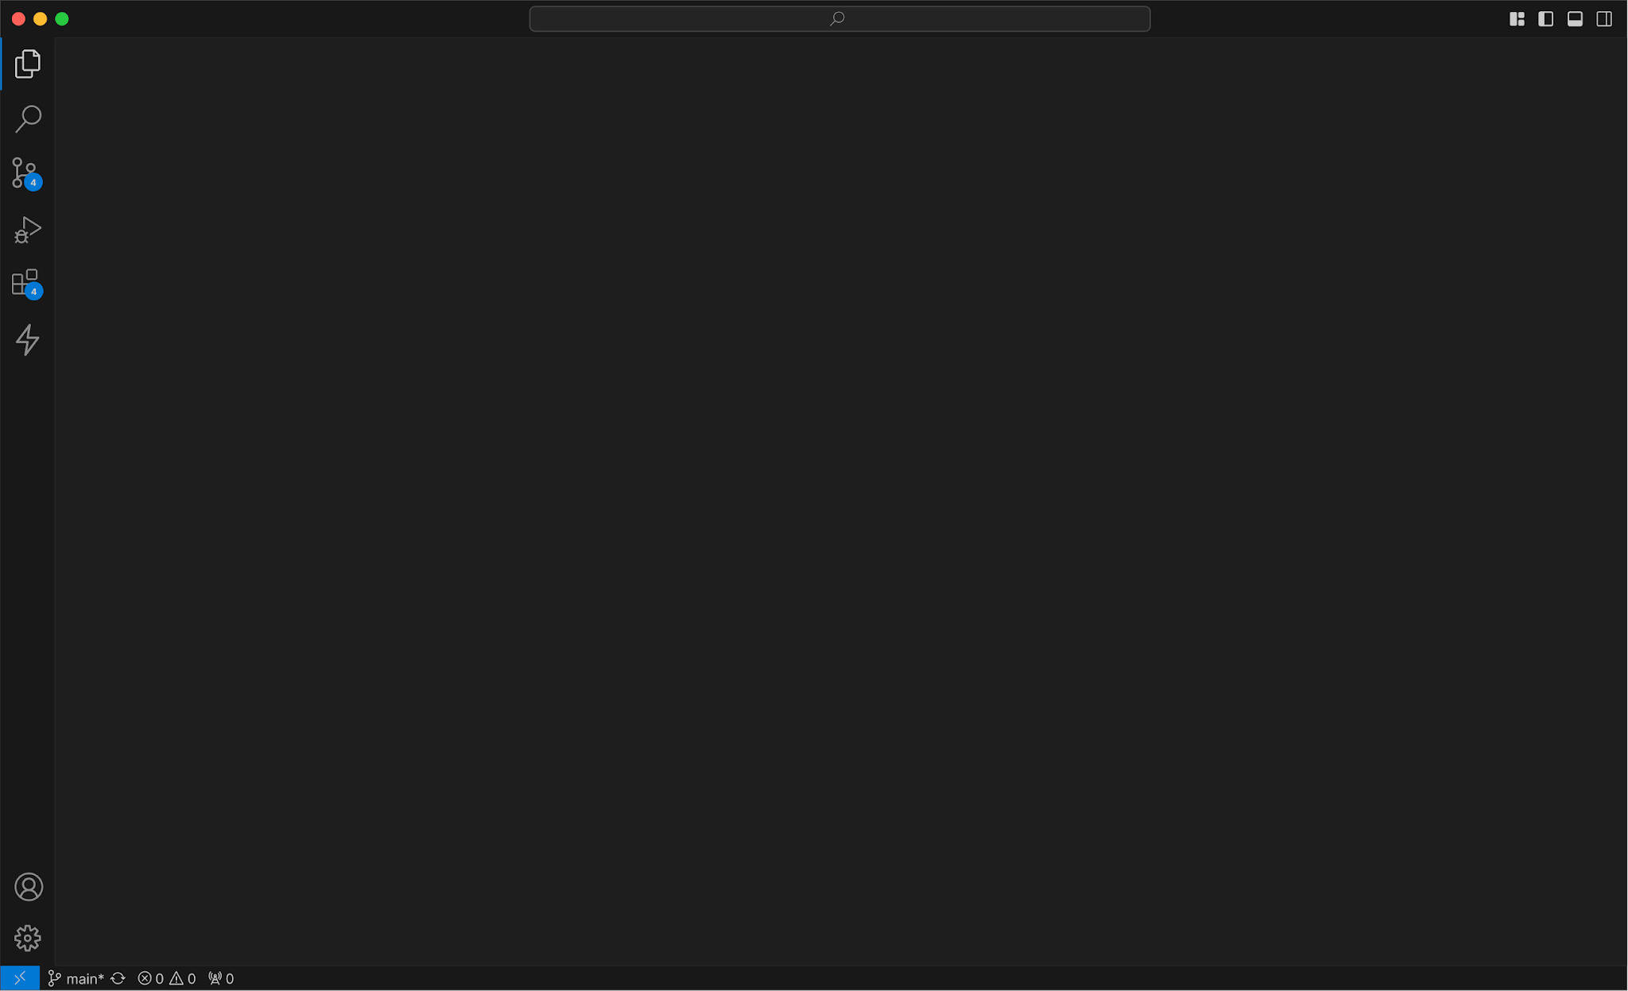
Education Team
Introduction to
JavaScript & (some) React
CS+SG
Week 03

Slide 2
Topics
JavaScript
  Functions, Objects, DOM
Gabriel Demo!!
React Introduction

Slide 3

JavaScript
JavaScript (JS) is a scripting language used on pretty much every single web page today; it is used to give websites behavior/functionality
JS gives websites life!!! Without it, you just have a basic nonfunctional page.
What does “functionality” mean?
Added interactivity (show/hide elements, change colors/texts, update content)
Handle user input & validation
Complete calculations & handle data
Talk to APIs (will learn in a few weeks!?)

Slide 4
Variables
// String
let color = “yellow”;
// Number
let length = 16;
let width = 15.5;
// Bigint
let x = 123456789012345678901234567890;
// Boolean
let b = true;
// Object
const cat = {name: ‘goose’, color: ‘grey’};
// Array Object
const cats = [‘kiki’, ‘goose’];
// Undefined
let u;
// Null
let n = null;
JS Variables are used to store data values. Variables act as placeholders for various types of information that can be manipulated and referenced within a program
Variable types ->
Different ways of declaring variables:
let (mutable, only available in the block they are defined)
const (not mutable)
var (mutable, available throughout func)
Let vs. Var

Slide 5
Functions
// Function Declaration
function myFunction(a, b) {
return a * b;
}
// Function Call
let x = myFunction(4, 3);
// Function Expressions
const a = function (a, b) {return a * b};
let y = a(4, 3);
// can print with console.log
console.log(x);
JS Functions are like defined sets of steps
Three important actions:
Function declarations
  construct/declare a function with a function keyword followed by a name, parameters, and body
Function calls
  Using the function, make sure to provide necessary parameters
Return statements
  Specifies what the function returns

Slide 6
Skipping - Function Examples
https://codepen.io/mmtaylo/pen/pvgrWQY?editors=0010

Slide 7
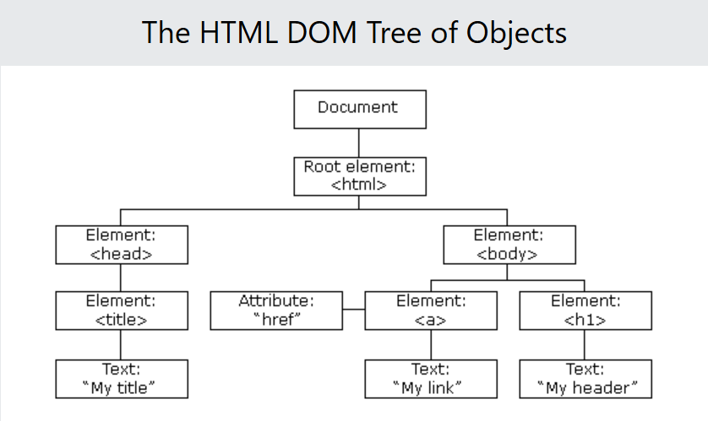
Document Object Model (DOM)
The Document Object Model (DOM) is the way the browser represents your web page as a structured tree of objects that JS can see and manipulate
<!DOCTYPE html>
<html lang="en">
<head>
<title>My Title</title>
</head>
<body>
<a href="contact.html">My Link</a>
<h1>My Header</h1>
</body>
</html>
Each element becomes a JS object!

Slide 8
DOM Manipulation
DOM Manipulation is a way to change your website after it has been loaded, aka respond to users in real time!
Codepen: https://codepen.io/mmtaylo/pen/LEGjOpy

Slide 9

React!
React is a JS library/framework that make it much easier to create functional websites by using components, which are really just JS functions
React uses .jsx files, which use a JS function to display HTML by “returning” it
Components are bits of code that can be reused throughout your website; they can be ‘fed’ different bits of information
When to use components?
Frequently recurring stagnant elements (header, nav, footer)
Elements that have the same structure but different details

Slide 10
How does React work?
React builds user interfaces using Components, which are just JS functions.
When a component is rendered, React:
Runs the component function
Returns the JSX (which looks like HTML, but is not HTML)
Updates the DOM
import myImg from "images/logo.png";
import Navigation from "./components/Navigation";
function App(){
// JS functions here
return (<>
<Navigation/>
<img src={myImg}/>
</>
);
}
export default App;

Slide 11
React Rules
A React file function must only return a singular element!
The function to be exported should be named the same as your .jsx file
Each file can only have only one default export
You must import images, components, styles before using them!
Use curly braces for your JS

Slide 12
React Routing
Routing allows you to navigate between different pages without reloading your browser; goes in your App.jsx file!
BrowserRouter “wraps” your app
Routes is a container for your routes
Route defines each path
  First route is where you want your users to enter first
import { BrowserRouter, Routes, Route } from "react-router-dom";
import Home from "./pages/Home";
import Profile from "./pages/Profile";
function App() {
return (
<BrowserRouter>
<Routes>
<Route path="/" element={<Home />} />
<Route path="/profile" element={<Profile />} />
</Routes>
</BrowserRouter>
);
}

